Slide 1

WIREFRAMES & PROTOTYPES: ESSENTIAL TOOLS FOR BUSINESS ANALYSTS
By Harshal Patil

Slide 2

AGENDA
What is a Wireframe? (And Why Do BAs Need Them?)
Understanding Prototypes (More Than Just a Pretty Picture)
Key Differences: Wireframes vs. Prototypes
The Business Analyst's Role in Wireframing & Prototyping
Tools of the Trade
Best Practices & Common Pitfalls
Q&A

Slide 3
BRIDGING THE GAP: FROM IDEA TO REALITY
Problem: Text-heavy requirements documents can be misinterpreted, leading to rework and project delays.
Solution: Visual communication! Wireframes and prototypes help stakeholders "see" the future product.
Benefit for BAs: Improved understanding, faster feedback, reduced ambiguity, and increased stakeholder buy-in.
Analogy: Building a house without blueprints vs. with blueprints.

Slide 4
WHAT IS A WIREFRAME?
Definition: A low-fidelity, static representation of a product's layout and functionality. Think of it as a skeleton.
Purpose: To focus solely on structure, content placement, and basic user flow, without design elements.
Key Characteristics:
Black and white (or grayscale)
Simple shapes, lines, and text placeholders
No colors, images, or detailed typography
Focus on "what" goes where, not "how it looks."
Example Image: (Insert a simple wireframe example – e.g., a login screen, a basic e-commerce product page)

Slide 5
THE BA'S SUPERPOWER: CLARITY THROUGH WIREFRAMES
Elicitation & Validation: Helps stakeholders visualize requirements and identify gaps early.
Clarifying Ambiguity: Translates abstract ideas into concrete visuals.
User Flow Mapping: Defines the user journey and interaction paths.
Early Feedback: Allows for quick iterations and cost-effective changes.
Communicating with Development: Provides a clear visual guide for developers and designers.
Prioritization: Helps stakeholders understand the relative importance of different features.

Slide 6
PROTOTYPES: BRINGING DESIGNS TO LIFE
Definition: A high-fidelity, interactive representation of a product, simulating its final look and feel.
Purpose: To test user experience, validate design choices, and gather comprehensive feedback on functionality and aesthetics.
Key Characteristics:
Interactive (clickable elements, transitions)
Includes colors, images, typography, and branding
Simulates real user interaction
Can range from medium to high fidelity

Slide 7
PROTOTYPES: VALIDATING THE EXPERIENCE
User Experience (UX) Testing: Allows for usability testing with real users.
Stakeholder Buy-in: Provides a tangible "feel" of the product, increasing confidence.
Reduced Development Risk: Identifies design flaws and usability issues before coding begins.
Refining Requirements: Uncovers hidden requirements or unexpected user behaviors.
Investor/Management Presentation: Powerful tool for demonstrating product vision.
Testing Complex Interactions: Ideal for understanding multi-step processes.

Slide 8
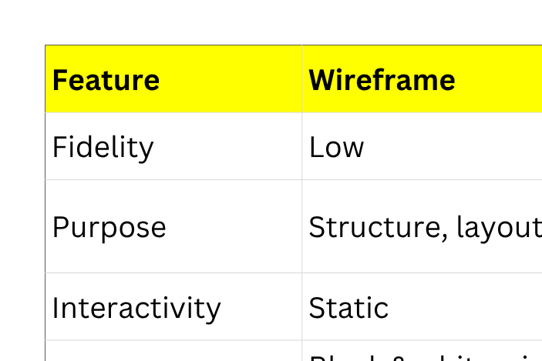
A TALE OF TWO VISUALS: WIREFRAMES VS. PROTOTYPES

Slide 9
THE BA'S CRUCIAL ROLE IN THE VISUAL DESIGN PROCESS
Translating Requirements: Converting functional and non-functional requirements into visual concepts.
Facilitating Workshops: Leading sessions to gather input and gain consensus on wireframes/prototypes.
User Flow Definition: Collaborating with UX/UI designers to define clear user journeys.
Feedback Collection & Management: Systematically gathering, analyzing, and incorporating stakeholder feedback.
Validation & Verification: Ensuring that the visuals accurately represent the agreed-upon requirements.

Slide 10
YOUR VISUAL DESIGN TOOLKIT
Low-Fidelity Wireframing:
Pen and Paper (Always a good starting point!)
Whiteboard
Balsamiq Mockups
Whimsical
Medium to High-Fidelity Prototyping:
Figma (Highly popular for collaboration)
Adobe XD
Sketch (Mac only)
InVision
Axure RP

Slide 11
MAXIMIZING IMPACT: TIPS FOR SUCCESS
Start Simple: Begin with low-fidelity wireframes to iterate quickly.
Collaborate Actively: Involve stakeholders, users, designers, and developers.
Focus on User Flow: Ensure the user journey is intuitive and logical.
Iterate, Iterate, Iterate: Be prepared to make multiple revisions based on feedback.
Provide Context: Explain why certain elements are placed where they are.
Document Decisions: Keep track of feedback and changes made.
Know Your Audience: Tailor the fidelity of your visuals to who you're presenting to.

Slide 12
CONCLUSION
Essential tools for clear communication and effective requirements validation.
Empower BAs to lead the visualization process, minimize risk, and accelerate delivery.
Crucial for ensuring that the developed product truly meets business needs and user expectations.
Invest in these skills to elevate your value as a Business Analyst!

Slide 13
Q&A
Thank You!

